Slide 1
Auto Reminder Workflow Architecture
IMRAN BASHA

Slide 2
Agenda
Context / Problem statement
Existing Cron workflow
Issues in the Cron workflow
SWF Workflow Architecture
Monitoring workflows
Demo

Slide 3
Context – Cron based workflows
Scheduled background jobs are typical requirement for any application.
Problems get multipled when the background has to execute as a distributed application in a cluster.
In our case we need to send automatic reminders on behalf of Small Business Owners (spread across more than dozen clusters) to millions of their customers when the invoices are overdue.
In the old way there was a Cron based workflow approach to achieve this feature “Auto Reminder”.
Notes:
Precise the 3rd bullet
In our case we have data from millions of customers that needs to be processed as batch job across several dozen compute clusters
We need to process millions of data for millions of customers spread across compute nodes

Slide 4
Old Cron workflow
Notes:
Create a Network topology
We have 50 clusters and talk about cluster topology. Talk about Admin host and Cron Host.
Increase font size

Slide 5
Cron workflow - Issues
Lost schedules
Co-ordination among Admin host and Cron Hosts
Admin host crash can be Single Point of Failure
Reliability
Cron host crash/fail can halt the processing
Scalability
Without configuration change we cannot scale out
Failure Handling
Failures in Cron hosts cannot be detected by Admin host
Inefficient
Uneven distribution of workload
Notes:
One machine dedicated as Admin Host. (SPF)
Add precise details on Reliability / Scalability
Not an efficient solution. This can lead to uneven distribution of Cron machines
Add a blog in Linked in

Slide 6
How SWF helps
SWF provides framework/services for executing distributed workflow on a periodic basis
Workflows can offload/divide the work to several workers running altogether in different machines through SWF as the medium
SWF takes care of co-ordination, scalability and failure handling among other things
Notes:
1. Introduce SWF in the context of the problem

Slide 7



Auto Reminder SWF Workflow Architecture
Activity Workers
Get Task
Trust boundary
Amazon
SWF
Long Poll
Send Reminder Worker
SWF Console / Workflow Starter
Starts execution of Cron Workflow
Send Reminder Tasks
Start Workflow Execution
Company List Tasks
Get Task
Trust boundary
Long Poll
Decision Tasks
Send Reminder Worker
Trust boundary
Execution History
Input Data
Timer Started
Timer Fired
Company List Completed
Reminder Completed
AutoReminder Workflow Worker
Get Task
Long Poll
Trust boundary
Get Task
CompanyList Worker
Long Poll
Notes:
Add one slide as what is SWF ?
Remove Firewall and add trusted boundary

Slide 8
Auto Reminder SWF Workflow

Slide 9
Infrastructure Architecture
Send Reminder Activity Worker
Send Reminder Activity Worker
Running in Cloud
AutoReminder Workflow Worker
Activity Host
Send Reminder Activity Worker
Send Reminder Activity Worker
Activity Host
CompanyList Activity Worker
:
:
Amazon
SWF
Send Reminder Activity Worker
Send Reminder Activity Worker
Workflow Host
Activity Host
Process boundary

Slide 10
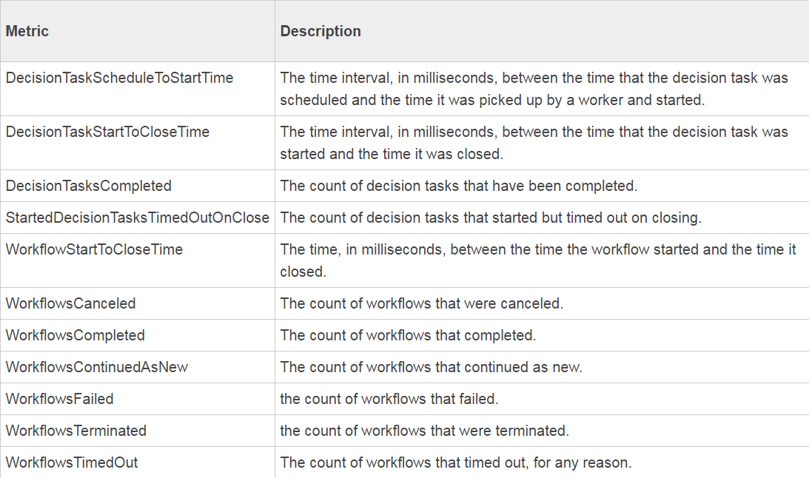
Monitoring
AWS CloudWatch for analytics on SWF application
Splunk based alerts for component/process level failures
Admin dashboard to manage worker
Notes:
Amazon CloudWatch is a monitoring service for AWS cloud resources and the applications you run on AWS. You can use Amazon CloudWatch to collect and track metrics, collect and monitor log files, set alarms, and automatically react to changes in your AWS resources.

Slide 11
AWS SWF Benefits
Highly scalable Distributed application
Activity workers can be added in run time to offload the work
Loose coupling among workers
Periodic Asynchronous workflow execution
Retry for failed activities
Reliable execution
If one worker dies other workers can offload the work
Takes care of Co-ordination among workers
Workflow State Management
Notes:
Amazon SWF has two key features that make it easy to scale a workflow application to handle the current load
1. A complete workflow execution history, which allows you to implement a stateless application.
2. Task scheduling that is loosely coupled to task execution, which makes it easy to scale your application to meet current demands.

Slide 12
DEMO
Notes:
Amazon SWF has two key features that make it easy to scale a workflow application to handle the current load
1. A complete workflow execution history, which allows you to implement a stateless application.
2. Task scheduling that is loosely coupled to task execution, which makes it easy to scale your application to meet current demands.

